Slide 1

RUNGTA COLLEGE OF DENTAL SCIENCES AND RESEARCH
FIXED PARTIAL DENTURE
    DEPARTMENT OF PROSTHODONTICS
PRESENTED BY:- DR. RUCHA KASHYAP

Slide 2
CONENTS
INTRODUCTION
CLASSIFICATION
ADVANTAGE/ DIS ADVANTAGE
INDIACATION/ CONTRAINDICATION
SELECTION OF ABUTMENT TEETH
TYPES OF ATTCHMENTS
SUMMARY
TAKE HOME MESSAGE
REFERENCES

Slide 3
SPECIFIC LEARNING OBJECTIVES
SR.NO | CORE AREA | DOMAIN | CATEGORY
1. | INTRODUCTION CLASSIFICATION | Cognitive | Must Know
2. | ADVANTAGE/ DIS ADVANTAGE INDIACATION/ CONTRAINDICATION SELECTION OF ABUTMENT TEETH TYPES OF ATTCHMENTS | Cognitive | Must Know
3. | SUMMARY | Affirmative | Must Know

Slide 4
PARTS OF FIXED PARTIAL DENTURE PROSTHESIS (F.P.D)

Slide 5
FPD
RETAINER
PONTICS
CONNECTORS

Slide 6
RETAINERS IN FIXED PARTIAL DENTURE PROSTHESIS

Slide 7
RETAINER
(in dentistry) Any type of device used for stabilization or retention of a prosthesis. (GPT)
CLASSIFICATION
Tylman classifies retainers as
Class I –
type 1 – anterior intracoronal retainer
type 2 – posterior intracoronal retainer
type 3 – anterior extracoronal retainer
type 4 – posterior extracoronal retainer

Slide 8
Class II –
type 1 – complete crown; metal alloy, porcelain or combination, without dowel
type 2 – complete crown with metal dowel; used on endodontically treated teeth

Slide 9
THE IDEAL RETAINER - qualities
Should be constructed and retained in mouth without injury to the pulp or adjacent tissues.
It should protect the pulp against thermal, galvanic shocks
The retainer which involve the least amount of tooth reduction and change of contour of the tooth while providing mechanical advantages are considered more ideal than those involving extensive preparation.
Should be capable of resisting distortion and displacement by forces of mastication and at the same time protect the tooth against fracture.

Slide 10
THE IDEAL RETAINER - qualities
Should have margins that are capable of being finished in areas which will prevent irritation of soft tissues and occurrence of caries.
Should be self cleansing
Should not tarnish or corrode in oral environment.
Should not discolour the abutment.
Should provide an esthetic restoration.

Slide 11
Selection of retainer:
Poor oral hygiene of the patient contraindicates the use of intra coronal retainer with long finish lines; complete coverage extracoroanal retainers are indicated in such situations.
According to the location in the arch and the expected masticatory load
Age of the patient and the dexterity with which the patient can undertake the home care procedures.
Location in the arch for esthetics.
Based on an analysis of the periodontal support of the abutment and length of the bridge.

Slide 12
PONTICS IN FIXED PARTIAL DENTURE PROSTHESIS

Slide 13
PONTICS
An artificial tooth on a fixed partial denture that replaces a missing natural tooth, restores its function and usually fills the space previously occupied by the clinical crown. (GPT)
Tylman defines Pontics as the suspended member of a fixed partial denture which replaces the lost natural tooth, restores function and occupies the space of the missing tooth.

Slide 14
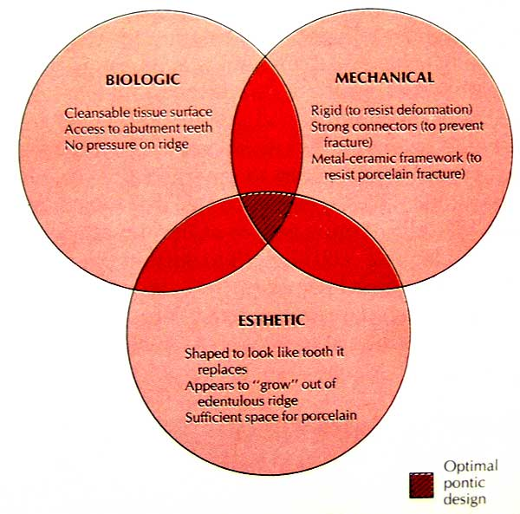
IDEAL REQUIREMENTS OF A PONTIC

Slide 15
CLASSIFICATION
According to Shillingburg, Pontics are classified :
Depending on the shape of the pontic contacting the tissues
Depending on the materials.
Depending upon the manufacturer’s design

Slide 16
1. On Shape
  Conical or root extension pontics
  Spheroidal pontic
  Ridge Lap pontic
  Modified ridge Lap
  Hygienic or Centric pontic
  Saddle pontic

Slide 17
2. On Materials used
All metal- Gold, cobalt-chromium, nickel- chromium etc.
Non metallic – Porcelain
Combination – Metal and porcelain, metal and resin

Slide 18
According to Rosenstiel -Pontic designs are classified into two general groups:
Those that contact the oral mucosa and those that do not.
A. Mucosal contact | B. No mucosal contact
1. Ridge lap | 1.Sanitary (hygienic)
2. Modified ridge lap | 2. Modified sanitary (hygienic)
3. Ovate
4. Conical

Slide 19
PONTIC SELECTION
Pontic selection depends primarily on esthetics and oral hygiene. In the anterior region, where esthetics is a concern, the pontic should be well adapted to the tissue to make it appear that it emerges from the gingival. Conversely, in the posterior regions (mandibular premolar and molar areas), esthetics can be compromised in the interest of designs that are more amenable to oral hygiene

Slide 20
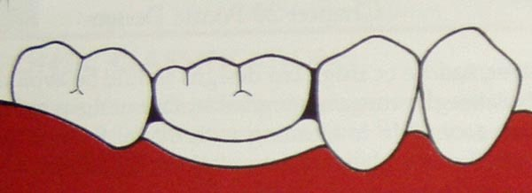
SANITARY OR HYGIENIC PONTIC
ADVANTAGES:
No tissue contact: atleast 2mm clearance between tissue and pontic;
self cleansing
Allows easy cleaning using floss, gauze strips etc.

Slide 21
DISADVANTAGES:
Poor esthetics; least “toothlike”
Food entrapment
Tongue habits may develop.
INDICATIONS:
Non esthetic zones of the oral cavity. (Mandibular molars)
Impaired oral hygiene of the patient.
CONTRAINDICATIONS:
Where esthetics is important.
Minimal vertical space for pontic placement.

Slide 22
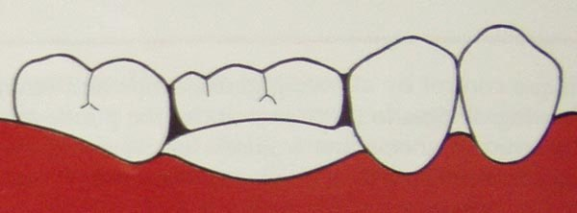
MODIFIED VERSION OF SANITARY PONTIC
Gingival portion is like an archway between the retainers.

Slide 23
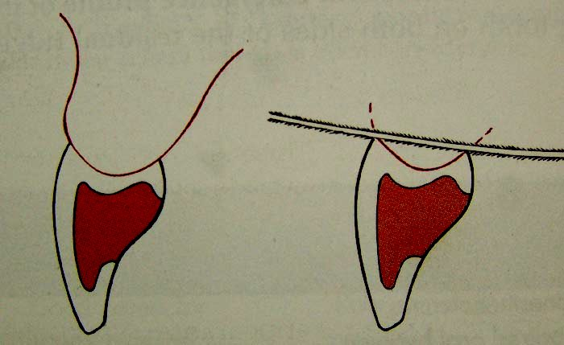
SADDLE OR RIDGE LAP PONTIC
The saddle pontic has a concave fitting surface that overlaps the residual ridge buccolingually, simulating the contours and emergence profile of the missing tooth on both sides of the residual ridge.

Slide 24
ADVANTAGES:
Esthetic.
DISADVANTAGES:
Convave surface of the pontic is not accessible fro home cleaning procdures.
Therefore plaque accumulation resulting in gingival inflammation.
NOT INDICATED IN ANY CLINICAL SITUATION

Slide 25
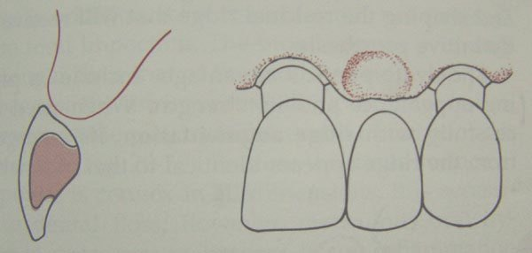
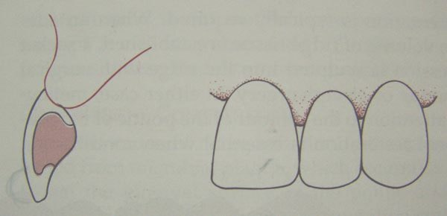
MODIFIED RIDGE LAP PONTIC
The modified ridge lap pontic combines the best features of the hygienic and saddle pontic designs, combining esthetics with easy cleaning.
The modified ridge lap design overlaps the residual ridge on the facial (to achieve the appearance of a tooth emerging from the gingival) but remain clear of the ridge on the lingual.

Slide 26
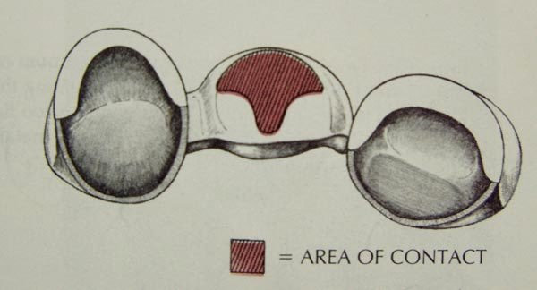
Contact with the ridge is at an area of maximum convexity and in a T-shape to enable home cleaning procedures.

Slide 27
ADVANTAGES:
Good esthetics
DISADVANTAGES:
Moderately easy to clean
INDICATIONS:
Areas with esthetic concern (anteriors, premolars, maxillary molars)
CONTRAINDICATIONS:
1. Where esthetics is of minimal concern.

Slide 28
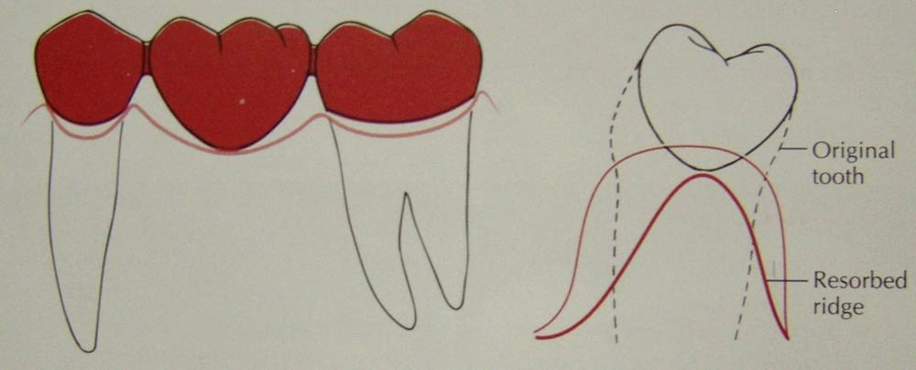
CONICAL PONTIC
Other names:
egg-shaped, bullet-shaped, or heart-shaped
It is made as convex as possible, with only one point of contact at the center of the residual ridge.

Slide 29
ADVANTAGES:
Good access for oral hygiene procedures.
DISADVANTAGES:
Poor esthetics
INDICATIONS:
Posterior areas where esthetics is minimal concern. (Mandibular molars)
Knife edge residual alveolar ridge.
CONTRAINDICATIONS:
1. Poor oral hygiene.

Slide 30
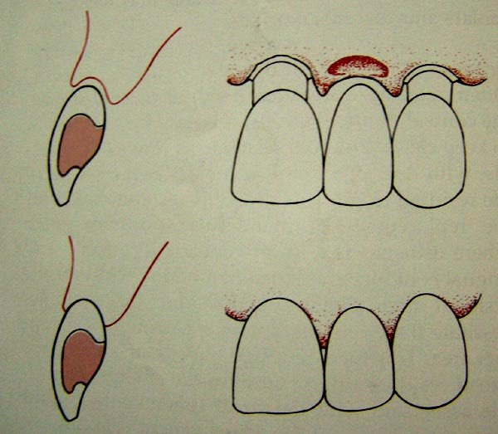
OVATE PONTIC
The ovate pontic is the most esthetically appealing pontic design. Its convex tissue surface resides in a soft tissue depression or hollow in the residual ridge, which makes it appear that a tooth is literally emerging from the gingival. Careful treatment planning is necessary for successful results.

Slide 31
ADVANTAGES:
Superior esthetics
Negligible food entrapment
Ease of cleaning
DISADVANTAGES:
Requires surgical preparation of the pontic site
INDICATIONS:
High esthetic requirements: anterior teeth, some premolars and maxillary molars sometimes
CONTRAINDICATIONS:
Resorbed residual alveolar ridge.

Slide 32
BIOLOGICAL CONSERIDATIONS FOR PONTICS:
Maintenance and preservation of the residual ridge.
Abutment and opposing teeth
Supporting tissue integrity.
FACTORS OF SPECIFIC INFLUENCE:
Ridge contact
Amenability to oral hygiene
Direction of occlusal forces

Slide 33
CONNECTORS IN FIXED PARTIAL DENTURE PROSTHESIS

Slide 34

That portion of the fixed partial denture that unites the retainer(s) and pontic(s) – GPT
Connector
Rigid
Non-rigid
cast
solder
weld

Slide 35
RIGID CONNECTORS:
Shaped and incorporated into wax pattern after individual retainer and pontic have been completed to final contour.
Cast connector:
Waxed on the master cast before reflowing and investing the pattern.
Use of cast connectors is limited to complete coverage restorations.
Advantage: simplified technique of fabrication of metal framework for FPD

Slide 36
SOLDERED CONNECTOR
Similar to the cat connector, these are waxed to the final contour and then sectioned with a thin ribbon saw. The individual patterns are then cast and thus obtained are castings with flat sides which can be easily re-oriented and soldered.
Advantage: facilitates accurate positioning of the units.

Slide 37
NON RIGID CONNECTORS
These are also incorporated in the wax pattern and consist of a mortise (female) and tenon (male) portion which accurately align into each other in the casting.
Female portion is usually placed on the distal aspect of the anterior retainer.
Can be custom made with paralleling done using a surveyor or precision milling machine. Pre-formed plastic components are also available which can be attached to the wax pattern and cast.

Slide 38
CONNECTOR DESIGN: requirements
Must be sufficiently large to prevent distortion or facture during function; but not too large to interfere with the effective plaque control.
Provide adequate access to the gingival surface of the pontic.
Highly polished.
Faciolingually- curved to facilitate cleaning
Buccolingually- elliptical shape
For anterior bridges: connectors are placed towards the lingual
For posterior: connectors are placed in the center of the tooth.

Slide 39
summary
Precision attachments serve the function of retention, stress distribution and aesthetics successfully. Appropriate selection of attachments, plays a major role in the success of treatment.
Use of precision attachment strengthens the aspects of retention and particularly, esthetics when compared to conventional removable partial dentures.

Slide 40
TAKE HOME MESSAGE
The clinicians who familiarize himself with precision attachments will add a new dimensions to his treatment options
Proper maintenance and care by the patient and regular follow up decides on the long term success of the attachment and prosthesis.

Slide 41
references
Kanathila H. et al., An insight into various attachments used in prosthodontics: A review, International Journal of Applied Dental Sciences, 2018; 4(4): 157-160
Mensor MC. Classification and selection of attachments. J Prosthet Dent. 1973; 29:494-97
Preiskel H.W. Precision attachments in Prosthodontics: The applications of intracoronal and extracoronal attachments, volume 1, Quintessence books
Preiskel H.W. Precision attachments for partially dentate mouth, Annals of the Royal College of Surgeons of England (I974), vol 55, 294-298

Slide 42
QUESTIONS
1. DEFINE PONTICS.EXPLAIN VARIOUS TYPES OF PONTICS USED IN FPD.
2.DESCRIBE THE COMPONENT PARTS OF FPD
SHORT NOTES-
1.KENNEDYS BAR
2.COMBINATIONS CLASP
3.REST AND REST SEAT
4.MAJOR CONNECTOR
5.DIRECT RETAINER

